Slide 1
Recent Years Recent Years Restaurant Health Violation Investigation In Boston
Submitted By: Heyao Zhang, Yiyi Zhang
Instructor: Sergiy Shevchenko

Slide 2
Introduction
We have a recent years’ violation report from research organization in Boston.
In raw dataset, each observation is one piece of information contains citizen report the violation level occurs in restaurants and investigation results (Pass or Fail).
We have over 500k observations and 26 variables.
Setting Environment: RStudio
Package required: ggplot2, plyr, lubridate, plotrix.

Slide 3
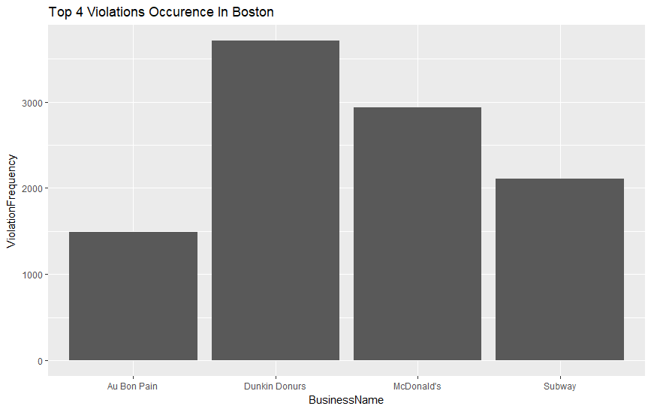
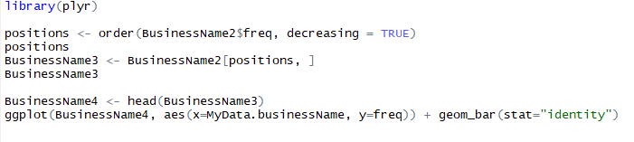
Statistics About Different Restaurant Violation
First sight of the data is businessname in the first columns. To get the result of Top violation occurrence in Boston, we just use count() and unique() function to calculate the frequency occurs in data processing,
Unfortunately, there are some business name spell different but same reference such as Dunkin Donuts and Dunkin’ Donuts. So that we have to do some manual operation to add it together.
Then, we could use order() to arrange the frequency from high to low. The ggplot() function could draw histogram to show the top 4 violation complaints and investigations restaurants in Boston.

Slide 4
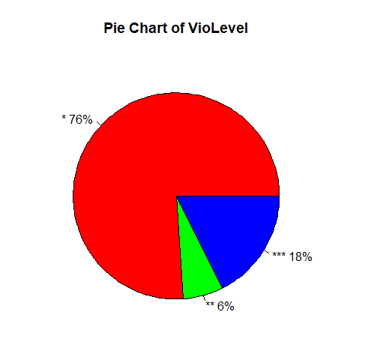
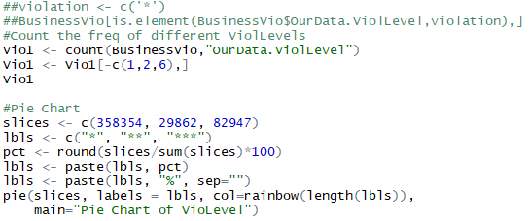
Statistics About Violation Levels
To get the basic summary of violation levels, use count() function to get data we need from raw data source. However, there are some parts of violation levels missing in raw data so that we have to remove the useless information to get the final result.

Slide 5
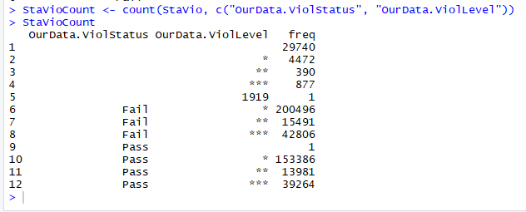
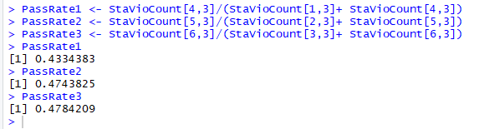
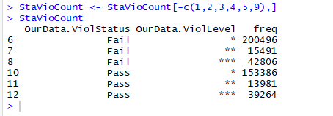
Pass rate in different violation levels
And then we are going to calculate the pass rate in different violation levels.
We need to remove 1,2,3,4,5,9 rows.
Result is below.

Slide 6
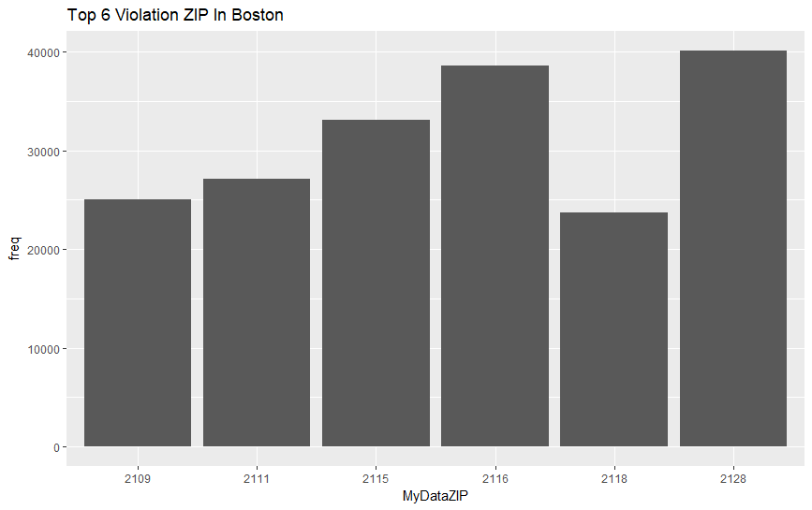
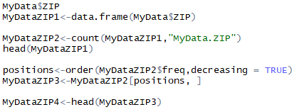
Statistics About Different Area Violation in Boston.
To get a summary about area violation, we use zip code attribution apply in count() and order() functions to get the top 6 violation occurrences zip area in Boston.
The result shows that 2128 is the most violations occurrences, I think it is because human traffic there is top rank in Boston.

Slide 7
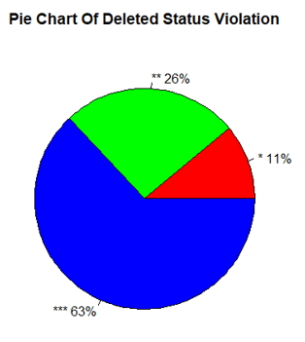
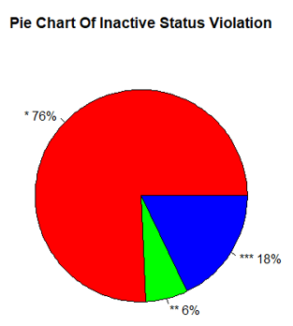
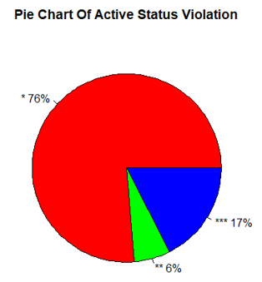
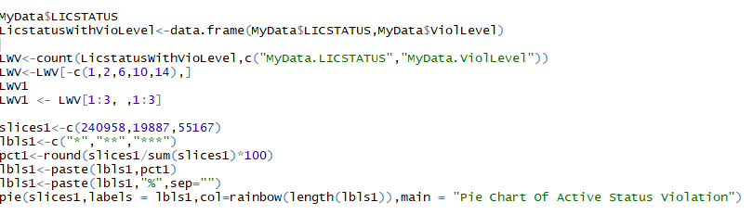
Statistics About Different License Status Violation in Boston.
Now, we have got different violation levels charts before, so we could compare the reason lead to that violation distribution.
By apart license status attributes from raw data, we could compare three different license status to get a conclusion.
From the charts, the deleted license status restaurants violate 3 level much more higher than other two. We could suggests consumers to avoid this kind of restaurants to get a food service

Slide 8
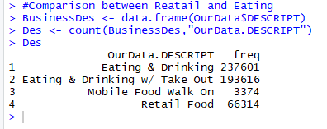
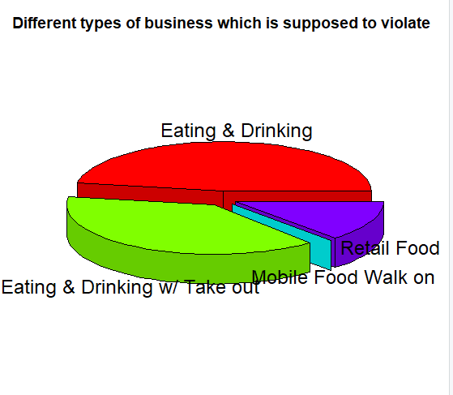
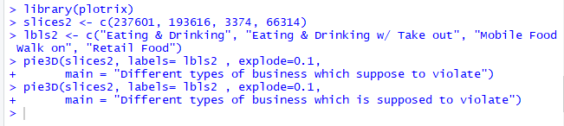
Different types of business which is supposed to violate
Counting which type of business was reported frequently.

Slide 9
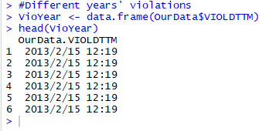

Different years’ violations
We would like to know different years’ violations.
The package ‘lubridate’ is necessary.
In the description of as.date function, we can see that our dataset has different format, so we need to transfer the format at first.
This is our dataset of date after improvement.

Slide 10
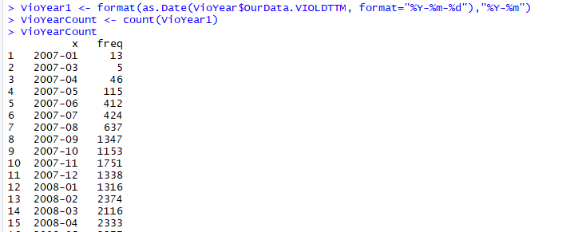
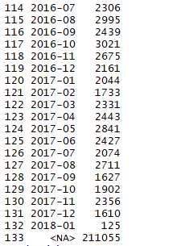
We can count the frequency of different months in 2007-2018.
But there are some <NA> (not available) data, that means we can’t use all the data, I think that’s the disadvantage. Then we should remove 133th row.

Slide 11
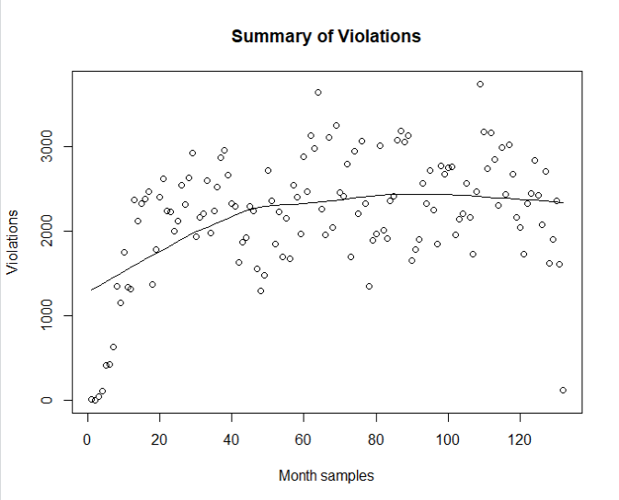
And then we will create a scatter plot for those data.
In this picture, we can see that as time goes, the violations appear stably in each month.
Maybe you will be confused about the x-axis, our dataset begins in Jan 2007 and ends in Jan 2018, so to the one specific year, for example, 2008, we have 12 month samples. Therefore, the x-axis is the sum of each year’s month.

Slide 12
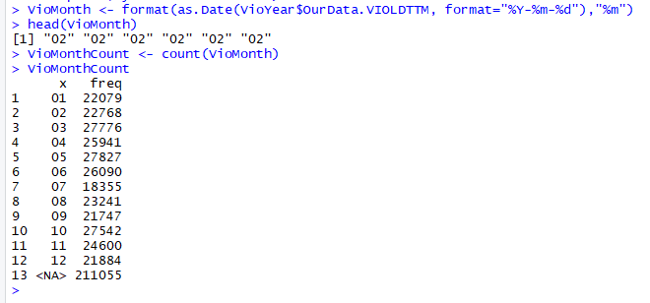
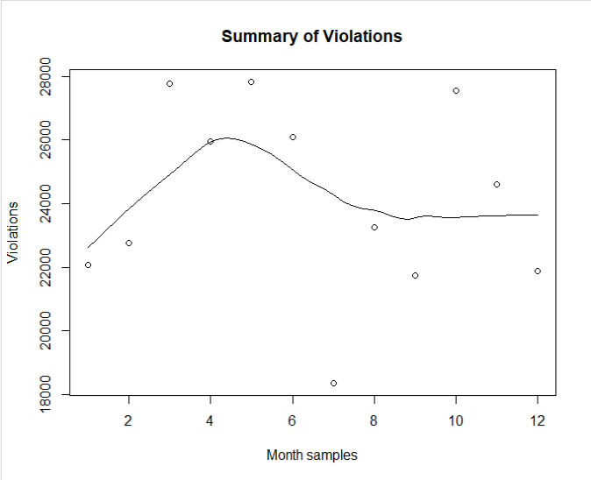
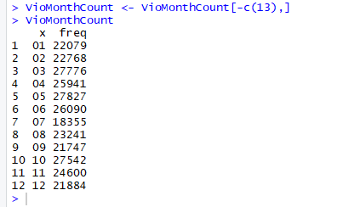
So, how about the relationship between specific month and violations?

Slide 13
Thank you!

